Slide 1
Conversion Roux Y Gastric Bypass After Sleeve Gastrectomy or One-Anastomosis Gastric Bypass for Gastroesophageal Reflux and Weight Re-gain
Germana Ginevra Perrone
MD Phd Student
Resident in General Surgery at Sapienza Università di Roma

Slide 2
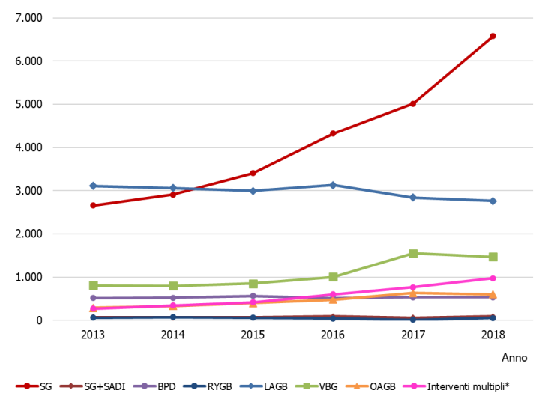
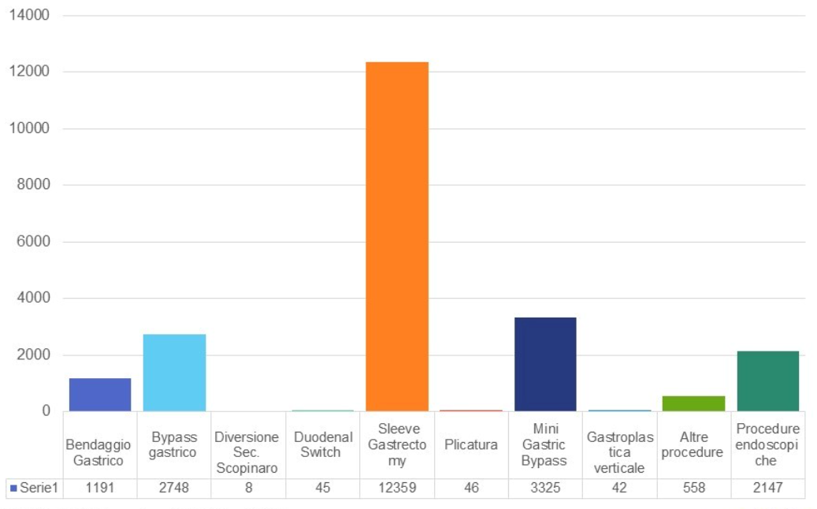
Conversion Roux Y Gastric Bypass After Sleeve Gastrectomy Or One-Anastomosis Gastric Bypass For Gastroesophageal Reflux And Weight Regain
Germana G. Perrone, Massimo Chiaretti, Pietro Ursi, Silvia Quaresima, Alessandro M. Paganini – Sapienza University of Rome
BACKGROUND
Fonte: Elaborazioni AGENAS su SDO 2013/2018 – NSIS
Dati ufficiali SICOB – aggiornati al 1 febbraio 2022
Notes:
Over the past 10 years, Sleeve Gastrectomy (SG) has rapidly become the most popular bariatric procedure, being less technically demanding, associated with low morbidity and mortality, significant weight loss and improvement of obesity-related comorbidities, without altering the esophago-gastro-duodenal continuity.
One Anastomosis Gastric Bypass (OAGB) has also been increasing more recently.

Slide 3
Conversion Roux Y Gastric Bypass After Sleeve Gastrectomy Or One-Anastomosis Gastric Bypass For Gastroesophageal Reflux And Weight Regain
Germana G. Perrone, Massimo Chiaretti, Pietro Ursi, Silvia Quaresima, Alessandro M. Paganini – Sapienza University of Rome
BACKGROUND
Hiatal hernia (HH) and Gastro-Esophageal Reflux Disease (GERD) are often concomitant conditions and are more frequent in obese patients than in non-obese patients 1
The HH rate in obese patient ranges from 5 to 50% 2
GERD, with or without HH, is present in 50-70% of obese patients candidates for bariatric surgery 3
Laparoscopic sleeve gastrectomy (LSG) is the most commonly performed procedure for morbid obesity treatment , but its results in patients with GERD are still controversial 4
1 Soricelli E et al. Sleeve gastrectomy and crural repair in obese patients with gastroesophageal reflux disease and/or hiatal hernia. Surg Obes Relat Dis. 2013 2 Reynoso JF et al. Primary and revisional laparoscopic adjustable gastric band placement in patients with hiatal hernia. Surg Obes Relat Dis. 2011 3 Che F et al. Prevalence of hiatal hernia in the morbidly obese. Surg Obes Relat Dis. 2013 4 Chiu S et al. Effect of sleeve gastrectomy on gastroesophageal reflux disease: a systematic review. Surg Obes Relat Dis. 2011
Notes:
Gastroesophageal reflux disease is a very common condition in patients with morbid obesity due to increased intra-abdominal pressure, and it is often associated with hiatal hernia, up to 50% of patients.

Slide 4
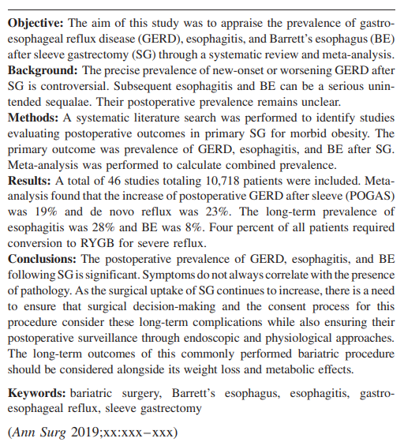
Conversion Roux Y Gastric Bypass After Sleeve Gastrectomy Or One-Anastomosis Gastric Bypass For Gastroesophageal Reflux And Weight Regain
Germana G. Perrone, Massimo Chiaretti, Pietro Ursi, Silvia Quaresima, Alessandro M. Paganini – Sapienza University of Rome
Notes:
However, the effect of sleeve gastrectomy on gastroesophageal reflux disease is still unclear, with conflicting evidence and opinions on the control of pre-existing reflux and new onset reflux after surgery. Roux-en-Y gastric bypass is considered the gold standard for the management of gastroesophageal reflux disease in obese patients, with excellent results in terms of reflux control and long-lasting weight loss, which warrants Roux-en-Y Gastric Bypass as revisional surgery after Sleeve or OAGB. Our aim is to report the results after redo RYGB.

Slide 5
Conversion Roux Y Gastric Bypass After Sleeve Gastrectomy Or One-Anastomosis Gastric Bypass For Gastroesophageal Reflux And Weight Regain
Germana G. Perrone, Massimo Chiaretti, Pietro Ursi, Silvia Quaresima, Alessandro M. Paganini – Sapienza University of Rome
March 2016 - March 2023
AGE | ± 48.5 Y
WEIGHT | ± 95.5 Kg
BMI | ± 34.11 Kg/m²
15 % ♂ | 85 % ♀
412 bariatric procedures
Notes:
From October 2006 to July 2023, out of 412 bariatric procedures we performed 50 RYGBs, 20 of which were revisional surgeries after Sleeve gastrectomy (95%) or OAGB (5%). 15% of patients were males and 85% were females. Average age was 48.45 years, average weight 95.5 Kg and average BMI 34.11 Kg/m². A hiatoplasty was associated in 30 % of our patients to repair the diaphragmatic defect responsible for the hiatal hernia.

Slide 6
Conversion Roux Y Gastric Bypass After Sleeve Gastrectomy Or One-Anastomosis Gastric Bypass For Gastroesophageal Reflux And Weight Regain
Germana G. Perrone, Massimo Chiaretti, Pietro Ursi, Silvia Quaresima, Alessandro M. Paganini – Sapienza University of Rome
Notes:
All patients who underwent revisional surgery suffered from GERD, 50% had Helicobacter Pylori gastritis, which was preoperatively eradicated, 25% had Obstructive Sleep Apnea Syndrome (OSAS), 40% had Hypertension (AH) and 10% were diabetic.

Slide 7
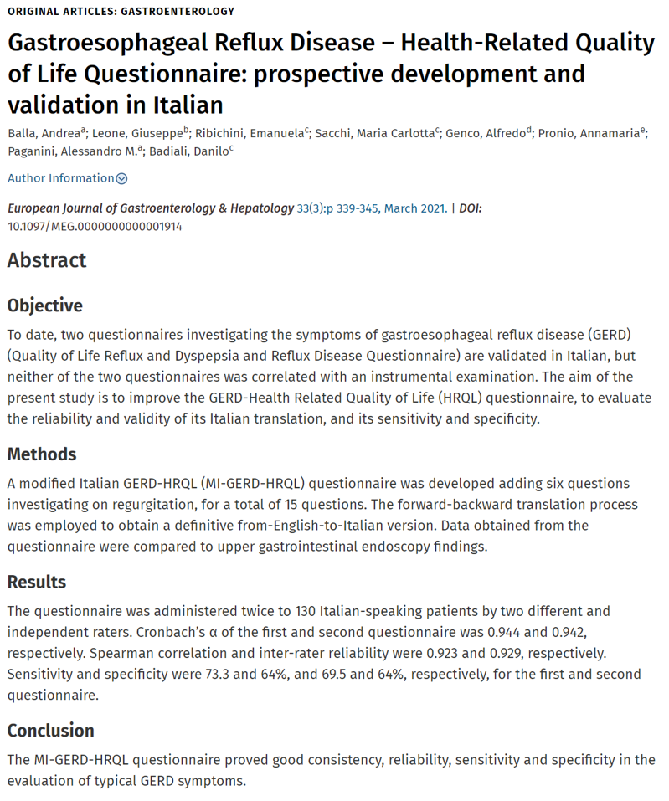
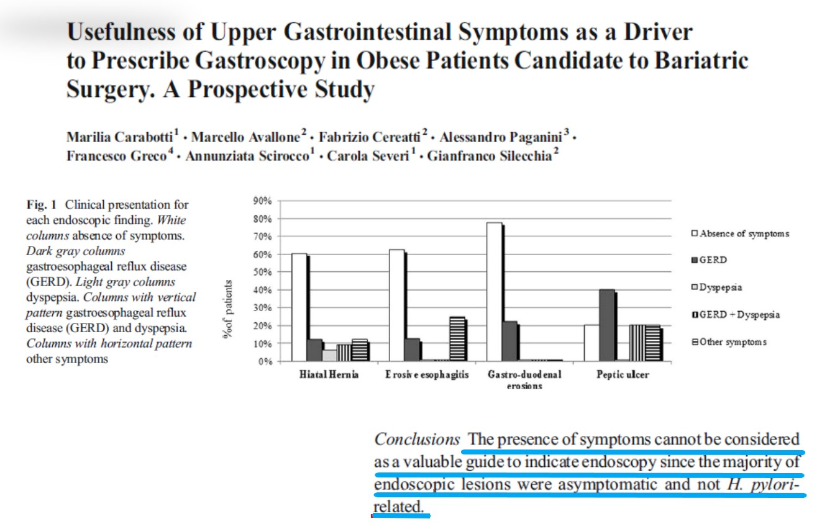
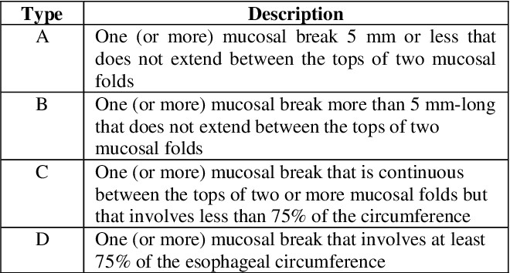
Conversion Roux Y Gastric Bypass After Sleeve Gastrectomy Or One-Anastomosis Gastric Bypass For Gastroesophageal Reflux And Weight Regain
Germana G. Perrone, Massimo Chiaretti, Pietro Ursi, Silvia Quaresima, Alessandro M. Paganini – Sapienza University of Rome
Notes:
Preoperative esophagogastroduodenoscopy (EGD) was routinely performed in our series because the diagnosis of GERD based only on symptoms may often be wrong, as reported in this prior paper. As you can see on the screen, 50% of our asymptomatic patients had lesions at routine EGD. When NERD was suspected, the patients underwent preoperative pH-monitoring studies. The clinical impact of GERD was quantified through the Italian GERD self-administration questionnaire.

Slide 8
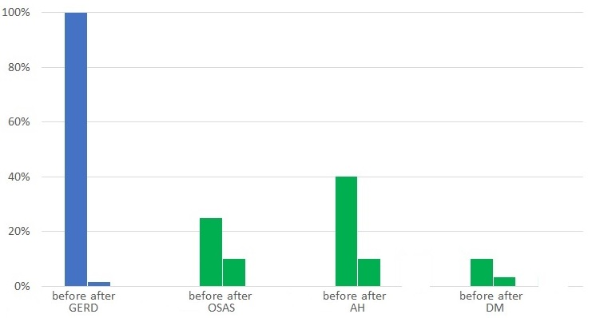
Conversion Roux Y Gastric Bypass After Sleeve Gastrectomy Or One-Anastomosis Gastric Bypass For Gastroesophageal Reflux And Weight Regain
Germana G. Perrone, Massimo Chiaretti, Pietro Ursi, Silvia Quaresima, Alessandro M. Paganini – Sapienza University of Rome
Mean BMI before | ± 34.11 Kg/m²
Mean BMI after | ± 27.60 Kg/m²
86.84 % EBWL
Notes:
At an average follow up of 38 months, we observed 100% GERD resolution, 66% diabetes remission, 25% still suffering from arterial hypertension, 12.5% of which discontinued antihypertensive therapy and 12.5% reduced antihypertensive therapy, 60% had OSAS resolution with no longer need of Continuous Positive Airway Pressure treatment. We registered 86.84% excess body weight loss and 27.60 mean BMI.

Slide 9
Grazie dell’attenzione

